Slide 1
Binary Search Trees
<
6
2
>
9
1
4
=
8
© 2013 Goodrich, Tamassia, Goldwasser
Binary Search Trees
Notes:
Dictionaries

Slide 2


Ordered Maps
Keys are assumed to come from a total order.
Items are stored in order by their keys
This allows us to support nearest neighbor queries:
  Item with largest key less than or equal to k
  Item with smallest key greater than or equal to k
© 2013 Goodrich, Tamassia, Goldwasser
Binary Search Trees

Slide 3

Binary Search
Binary search can perform nearest neighbor queries on an ordered map that is implemented with an array, sorted by key
  similar to the high-low children’s game
  at each step, the number of candidate items is halved
  terminates after O(log n) steps
Example: find(7)
0
1
3
4
5
7
8
9
11
14
16
18
19
l
m
h
0
1
3
4
5
7
8
9
11
14
16
18
19
l
m
h
0
1
3
4
5
7
8
9
11
14
16
18
19
l
m
h
0
1
3
4
5
7
8
9
11
14
16
18
19
© 2013 Goodrich, Tamassia, Goldwasser
l=m =h
Binary Search Trees

Slide 4

Search Tables
A search table is an ordered map implemented by means of a sorted sequence
  We store the items in an array-based sequence, sorted by key
  We use an external comparator for the keys
Performance:
  Searches take O(log n) time, using binary search
  Inserting a new item takes O(n) time, since in the worst case we have to shift n/2 items to make room for the new item
  Removing an item takes O(n) time, since in the worst case we have to shift n/2 items to compact the items after the removal
The lookup table is effective only for ordered maps of small size or for maps on which searches are the most common operations, while insertions and removals are rarely performed (e.g., credit card authorizations)
© 2013 Goodrich, Tamassia, Goldwasser
Binary Search Trees

Slide 5
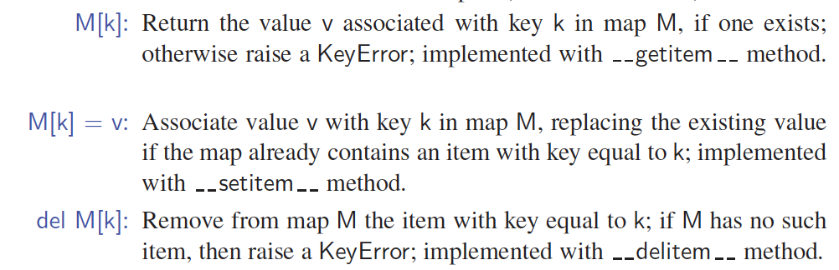
Sorted Map Operations
Standard Map methods:
The sorted map ADT includes additional functionality, guaranteeing that an iteration reports keys in sorted order, and supporting additional searches such as find_gt(k) and find_range(start, stop).
© 2013 Goodrich, Tamassia, Goldwasser
Binary Search Trees

Slide 6

Binary Search Trees
A binary search tree is a binary tree storing keys (or key-value items) at its nodes and satisfying the following property:
  Let u, v, and w be three nodes such that u is in the left subtree of v and w is in the right subtree of v. We have
  key(u) ≤ key(v) ≤ key(w)
External nodes do not store items, instead we consider them as None
An inorder traversal of a binary search trees visits the keys in increasing order
6
2
9
1
4
8
© 2013 Goodrich, Tamassia, Goldwasser
Binary Search Trees

Slide 7
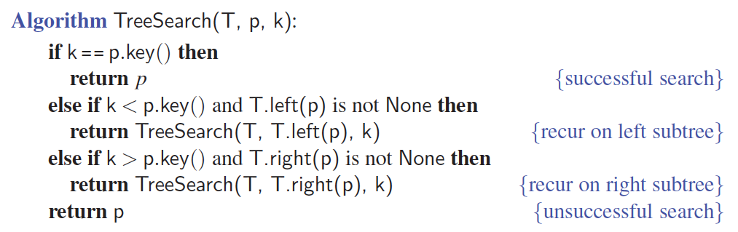
Search
To search for a key k, we trace a downward path starting at the root
The next node visited depends on the comparison of k with the key of the current node
If we reach a leaf, the key is not found
Example: find(4):
  Call TreeSearch(4,root)
The algorithms for nearest neighbor queries are similar
<
6
2
>
9
1
4
=
8
© 2013 Goodrich, Tamassia, Goldwasser
Binary Search Trees
Notes:
Dictionaries

Slide 8
Insertion
<
6
To perform operation put(k, o), we search for key k (using TreeSearch)
Assume k is not already in the tree, and let w be the (None) leaf reached by the search
We insert k at node w and expand w into an internal node
Example: insert 5
2
>
9
1
4
>
8
w
6
2
9
1
4
8
w
5
© 2013 Goodrich, Tamassia, Goldwasser
Binary Search Trees

Slide 9
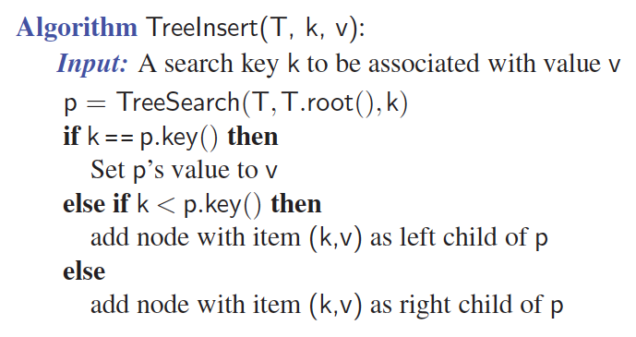
Insertion Pseudo-code
© 2013 Goodrich, Tamassia, Goldwasser
Binary Search Trees

Slide 10
Deletion
To perform operation remove(k), we search for key k
Assume key k is in the tree, and let let v be the node storing k
If node v has a (None) leaf child w, we remove v and w from the tree with operation removeExternal(w), which removes w and its parent
Example: remove 4
<
6
2
>
9
1
4
v
8
w
5
6
2
9
1
5
8
© 2013 Goodrich, Tamassia, Goldwasser
Binary Search Trees

Slide 11
Deletion (cont.)
1
v
We consider the case where the key k to be removed is stored at a node v whose children are both internal
  we find the internal node w that follows v in an inorder traversal
  we copy key(w) into node v
  we remove node w and its left child z (which must be a leaf) by means of operation removeExternal(z)
Example: remove 3
3
2
8
6
9
w
5
z
1
v
5
2
8
6
9
© 2013 Goodrich, Tamassia, Goldwasser
Binary Search Trees

Slide 12
Performance
Consider an ordered map with n items implemented by means of a binary search tree of height h
  the space used is O(n)
  Search and update methods take O(h) time
The height h is O(n) in the worst case and O(log n) in the best case
© 2013 Goodrich, Tamassia, Goldwasser
Binary Search Trees

Slide 13
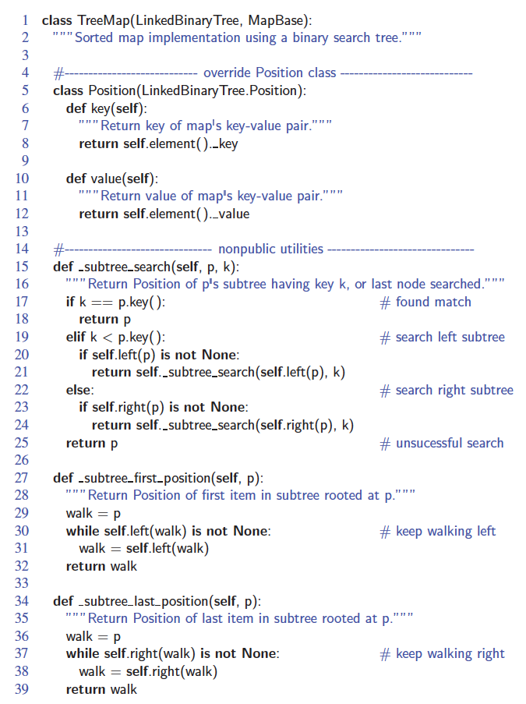
Python Implementation
© 2013 Goodrich, Tamassia, Goldwasser
Binary Search Trees

Slide 14
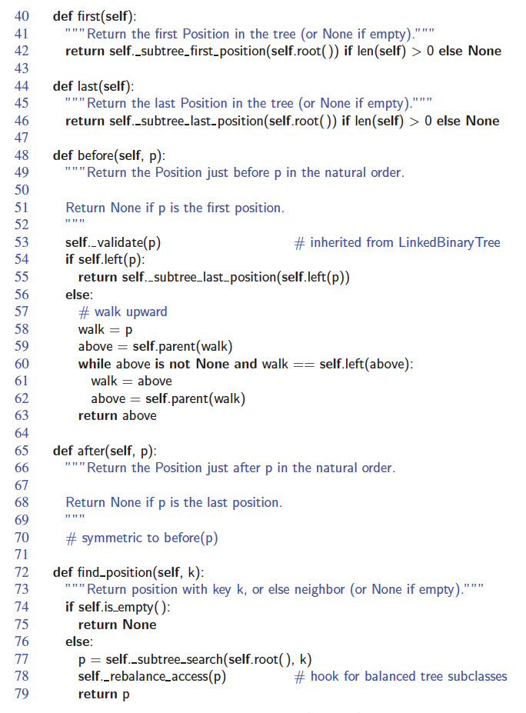
Python Implementation, Part 2
© 2013 Goodrich, Tamassia, Goldwasser
Binary Search Trees

Slide 15
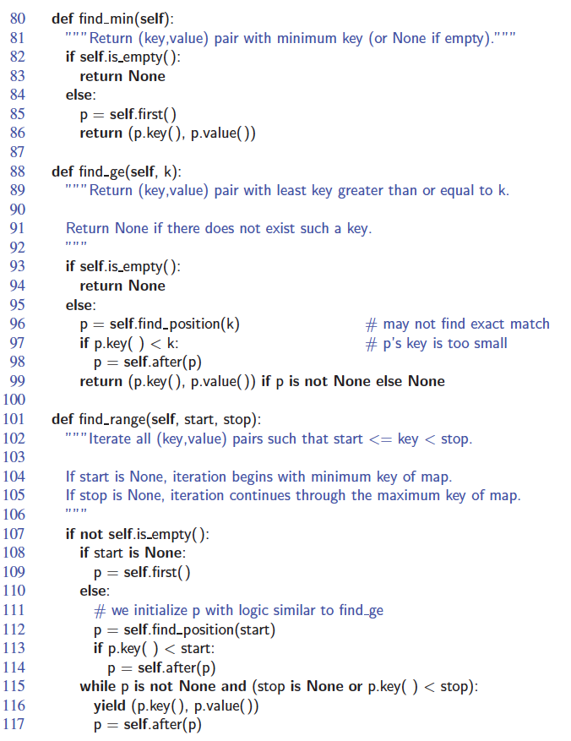
Python Implementation, Part 3
© 2013 Goodrich, Tamassia, Goldwasser
Binary Search Trees

Slide 16
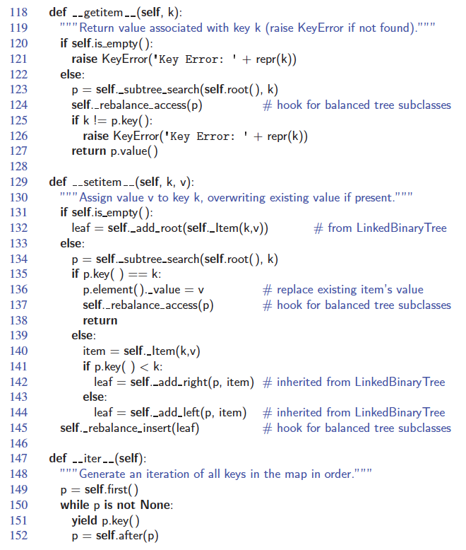
Python Implementation, Part 4
© 2013 Goodrich, Tamassia, Goldwasser
Binary Search Trees

Slide 17
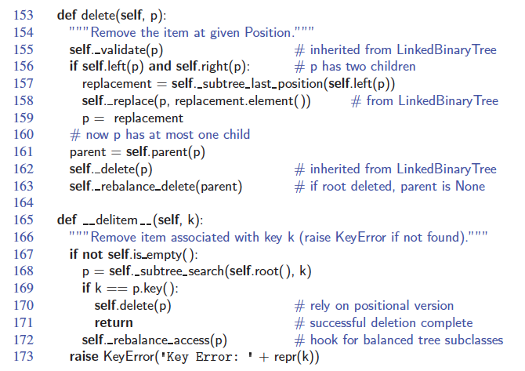
Python Implementation, end
© 2013 Goodrich, Tamassia, Goldwasser
Binary Search Trees

